Slide 1
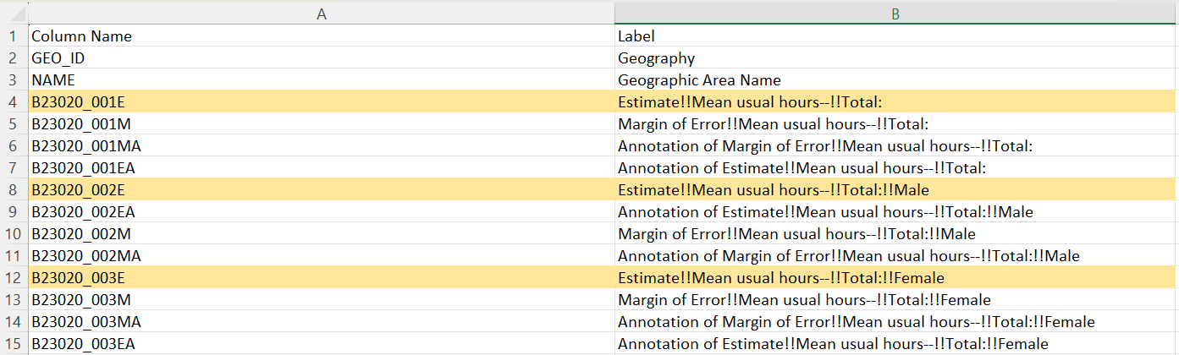
Mean work time data

Slide 2
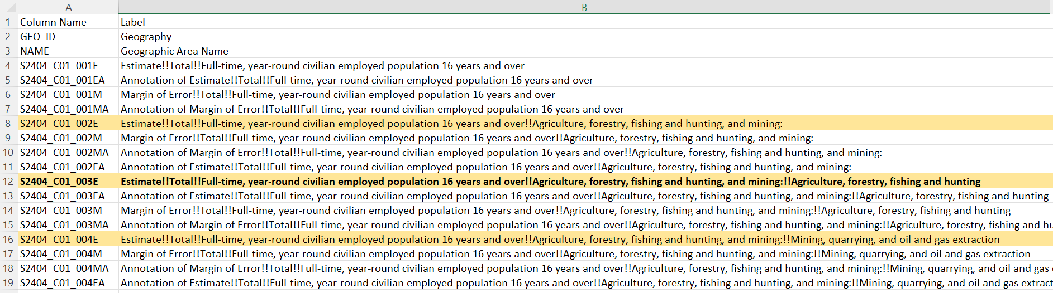
Work sector data

Slide 3
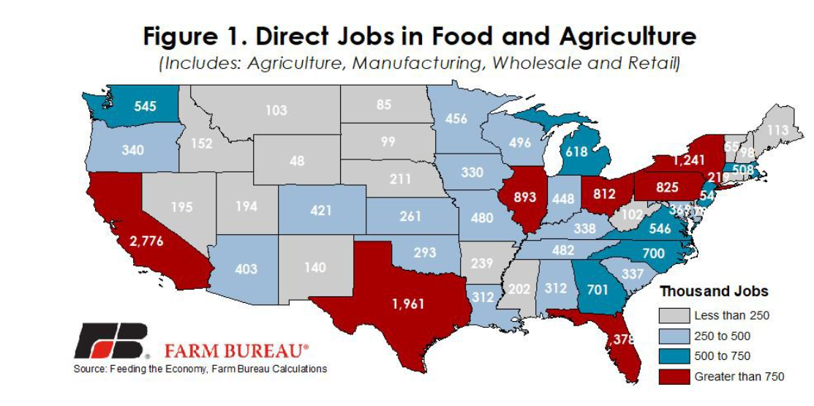
Feeding the Economy: Agricultural Jobs by State | Market Intel | American Farm Bureau Federation (fb.org)

